Slide 1
DDoS attack
Masoud Erfani

Slide 2
1 – Introduction
2 – Related work
3 – Findings
4 – result
5 – Conclusion

Slide 3
Introduction:
DDoS is short for Distributed Denial of Service. DDoS is a type of DOS attack where multiple compromised systems, which are often infected with a Trojan, are used to target a single system causing a Denial of Service (DoS) attack.
DDoS attacks are costing enterprises anywhere between $50,000 to $2.3 million per year.
Making DDoS detection important!

Slide 4
Related work:
Papers focused on extracting flow features from network traffic.
Such as Developing Realistic Distributed Denial of Service (DDoS) Attack Dataset and Taxonomy paper providing with best features for detection.
Different papers then requested applying new machine learning algorithms to predict based on these features.
Such as Network Traffic Behavioral Analytics for Detection of DDoS Attacks.

Slide 5
Findings:
Based on papers these features were used for detection:
Flow duration: Flow duration is a session of packets between a source IP and port to a destination IP and port
Number of packets in a forward direction:. Also, the forward direction is when the packet moves from say A to B.

Slide 6
These features were implemented by \cite{lopez} and they are considered as two important features for detection.
According to \cite{8888419}, Flow Duration is a proper feature for detecting SYN attack.Also, the number of forwarding packets is one of the most important features for detecting DrDoS-MSSQL attack in which, attacker abuses the Microsoft SQL Server Resolution Protocol (MC-SQLR) and sends millions of packets to the victim.
DDoS attacks have clear behavior in sending packets to the victim. This behavior affects the arrival rate and so, it affects the mention features. So, they can be used for DDOS detection.

Slide 7
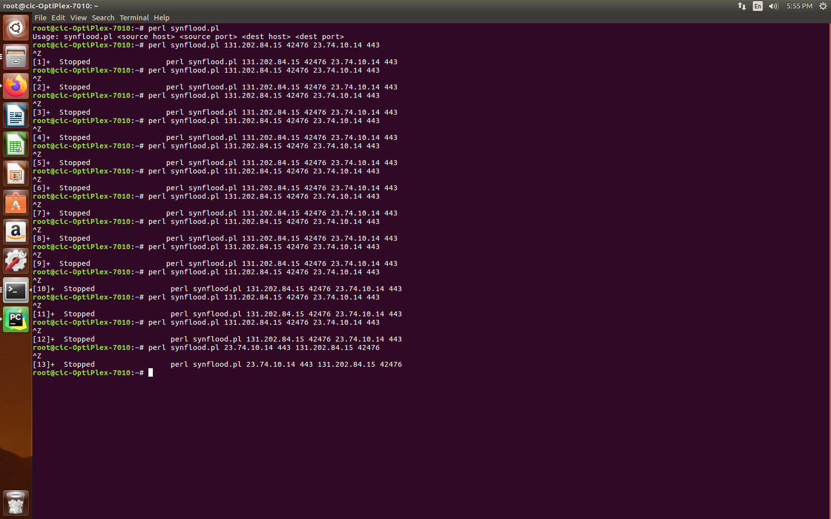
Results: Running attack: based on this github source code: https://github.com/soarpenguin/perl-scripts/blob/master/synflood.pl

Slide 8
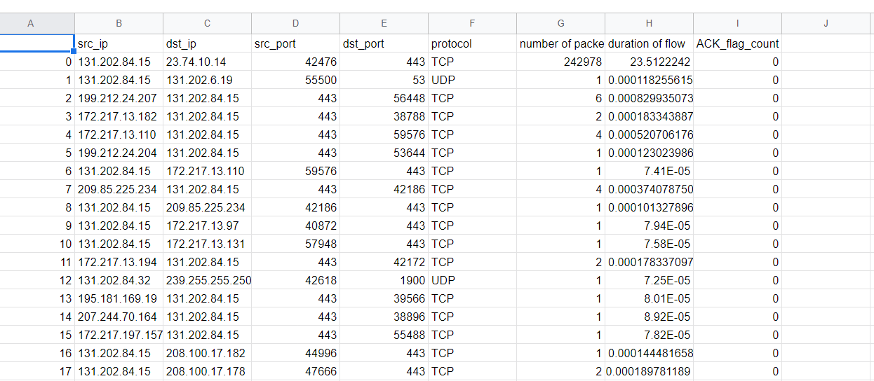
First row is our attack that is detected.

Slide 9
Conclusion:
Flow based features were used for DDoS detection.
1- Flow Duration
2 – Number of packets in forward direction

